Slide 1
Socket Programming
Java

Slide 2
Contents
Socket
Supporting Classes
Socket Functions
TCP Example
TCP Client
TCP Server

Slide 3
Socket
Socket
Source ( IP , Port )
Destination ( IP , Port )
Protocol ( TCP , UDP , SCTP)
Connection Oriented / Connection less

Slide 4
Socket Functions
TCP | UDP
socket bind listen accept connect write /send read / recv | socket bind sendto recvfrom

Slide 5
Socket Functions
socket: creates a socket of a given domain, type, protocol (buy a phone)
bind: assigns a name to the socket (get a telephone number)
listen: specifies the number of pending connections that can be queued for a server socket. (call waiting allowance)
accept: server accepts a connection request from a client (answer phone)
connect: client requests a connection request to a server (call)
send, sendto: write to connection (speak)
recv, recvfrom: read from connection (listen)
shutdown: end the call

Slide 6
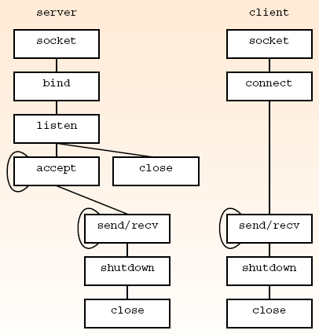
Sockets Functions used for TCP

Slide 7
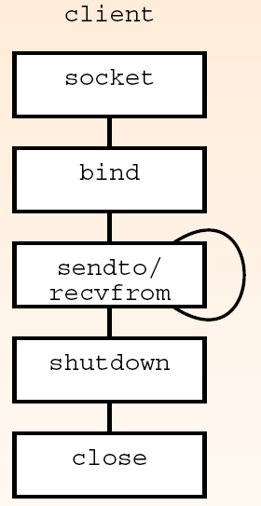
Sockets Functions used for UDP

Slide 8
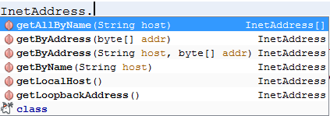
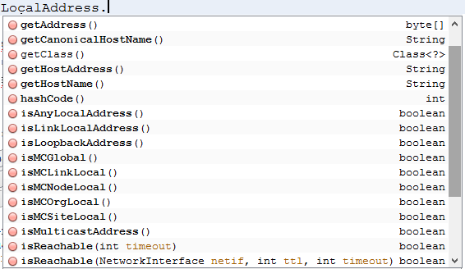
Supporting Classes & Objects

Slide 9
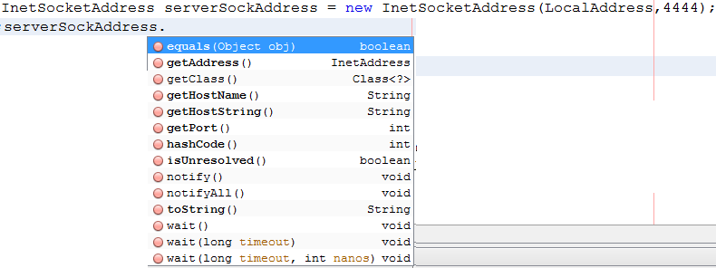
Supporting Classes & Objects

Slide 10
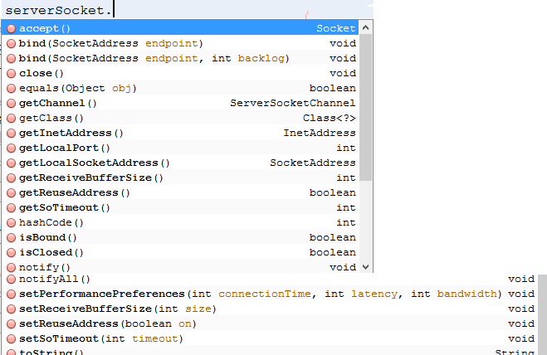
Class ServerSocket

Slide 11
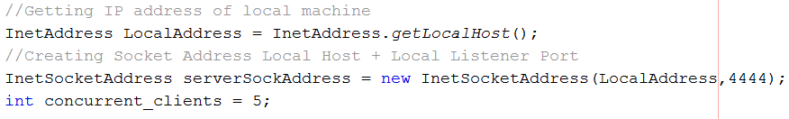
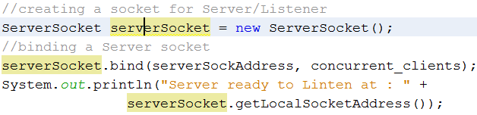
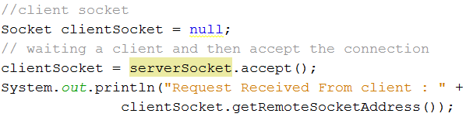
TCP Chat Server

Slide 12
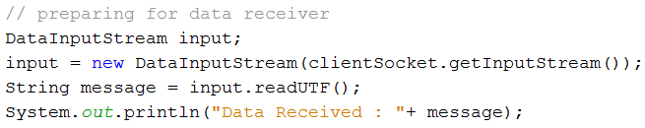
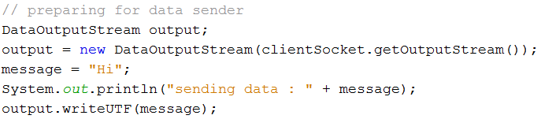
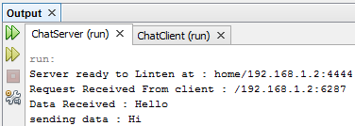
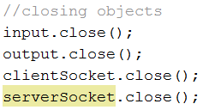
TCP Chat Server

Slide 13
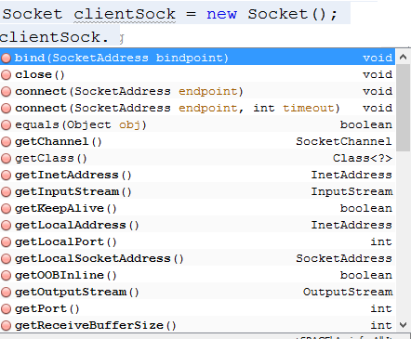
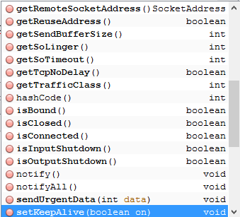
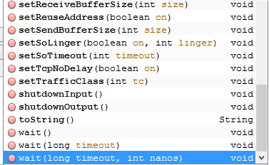
Class Socket

Slide 14
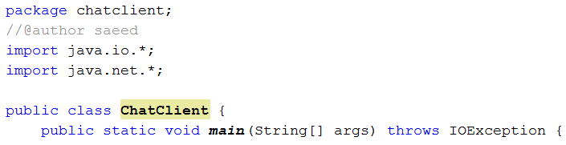
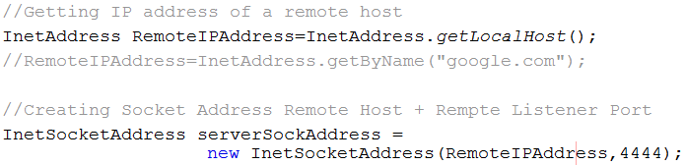
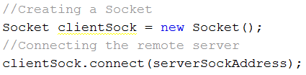
TCP Chat Client

Slide 15
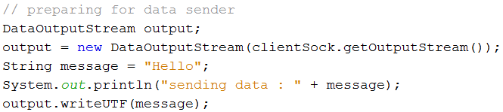
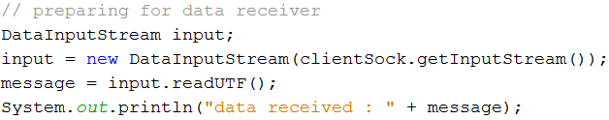
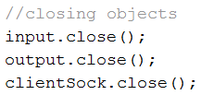

TCP Chat Client

Slide 16
Assignment
Write a Form based application for Chatting
Add support of User Login.
Save Chat between two clients in database.
At user login show chat log of last 10 days.
Multi-threaded Client/Server Applications
http://www.ase.md/~aursu/ClientServerThreads.html

